Slide 1
Learn Redis
SCAN & MATCH

Slide 2
SCAN
Iterates the set of keys in the database
Returns only a small amount per call
Can be used in production
Takes cursor / position as a parameter

Slide 3
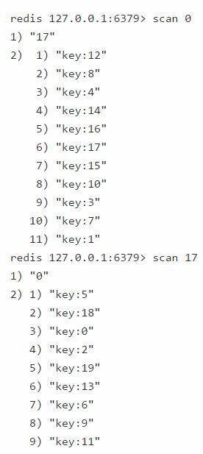
Cursor Based Iterator
The server returns an updated cursor with every call of the command
This can be used in the argument of the next call
Iteration starts when cursor is set to 0
Terminates when cursor returned from the server is 0
SCAN 0

Slide 4
SCAN Guarantees
Full iterations will retrieve all elements that were present in the collection from the start to the end
Never returns any element that was NOT present in the collection from the start to finish

Slide 5
COUNT Option
COUNT can be defined in a SCAN command to overwrite the default returned per iteration
The user can specify the amount of work done at every call
Default COUNT is 10
COUNT can be changed from one iteration to the next
SCAN COUNT 20

Slide 6
MATCH Option
Iterate elements that match a pattern specified
SCAN 0 MATCH something
SCAN 0 MATCH k*

Slide 7
Scan With Other Data Types
SSCAN – Used with sets. Returns list of set members
HSCAN – Used with hashes. Returns array of elements with a field and value
ZSCAN – Used with sorted sets. Returns array of elements with associated score

Slide 8
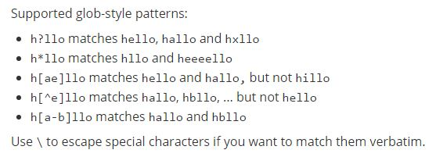
KEYS Pattern
Returns all keys that match a specific pattern
Should be avoided in production environments
KEYS *

Slide 9
RANDOMKEY
Returns a random key from the database
RANDOMKEY

Slide 10


